Slide 1
Digital Portfolio
STUDENT NAME:RITHANYA S
REGISTER NO AND NMID: 2422K0091/ B167A7CB105FAA3811544B8ADDB7209E
DEPARTMENT: COMPUTER SCIENCE
COLLEGE: KPR COLLEGE OF ARTS SCIENCE AND RESEARCH
UNIVERSITY: BHARATHIYAR UNIVERSITY

Slide 2
PHOTOGRAPHY PORTFOLIO WEBSITE

Slide 3


AGENDA
Problem Statement
Project Overview
End Users
Tools and Technologies
Portfolio design and Layout
Features and Functionality
Results and Screenshots
Conclusion
Github Link
3/21/2024 Annual Review

Slide 4

PROBLEM STATEMENT
Photographers need a digital space to showcase their work.
Traditional portfolios are limited and not accessible online
aim: to create a responsive photography website using HTML,CSS and JavaScript
Many portfolios lack responsiveness and don’t adapt to different devices (mobile,tablet,desktop)
There is a need for a light weight ,single page portfolio website built with basic web technologies(HTML,CSS,JavaScript)

Slide 5

PROJECT OVERVIEW
A single page photography portfolio website
Includes home ,gallery ,about,and contact sections
Designed with a clean layout and responsive grid gallery
Simple javascript lightbox effect to view photos.
It provides a digital platform for photographers to present their work in a structured ,creative , and professional way.

Slide 6

WHO ARE THE END USERS?
Professional and student photographers.
Anyone who wants to showcase creative work online
Recruiters or clients looking at portfolio work
Event planners or agencies
General audience or art enthusiasts

Slide 7

TOOLS AND TECHNIQUES
HTML5 _website structure
CSS3 _ design & responsiveness
Javascript _ interactivity(lightbox & form handling)
VS code _ code editor
GitHub _ version control & project submission

Slide 8
POTFOLIO DESIGN AND LAYOUT
Header section : project title and tagline
Gallery section : grid layout with clickable images
About section : description about the photographer
Contact section : simple form for communication
8

Slide 9
FEATURES AND FUNCTIONALITY
Responsive layout (mobile friendly)\
Interactive image gallery with lightbox
Easy to update photos
Simple form submission (with JS alert)

Slide 10
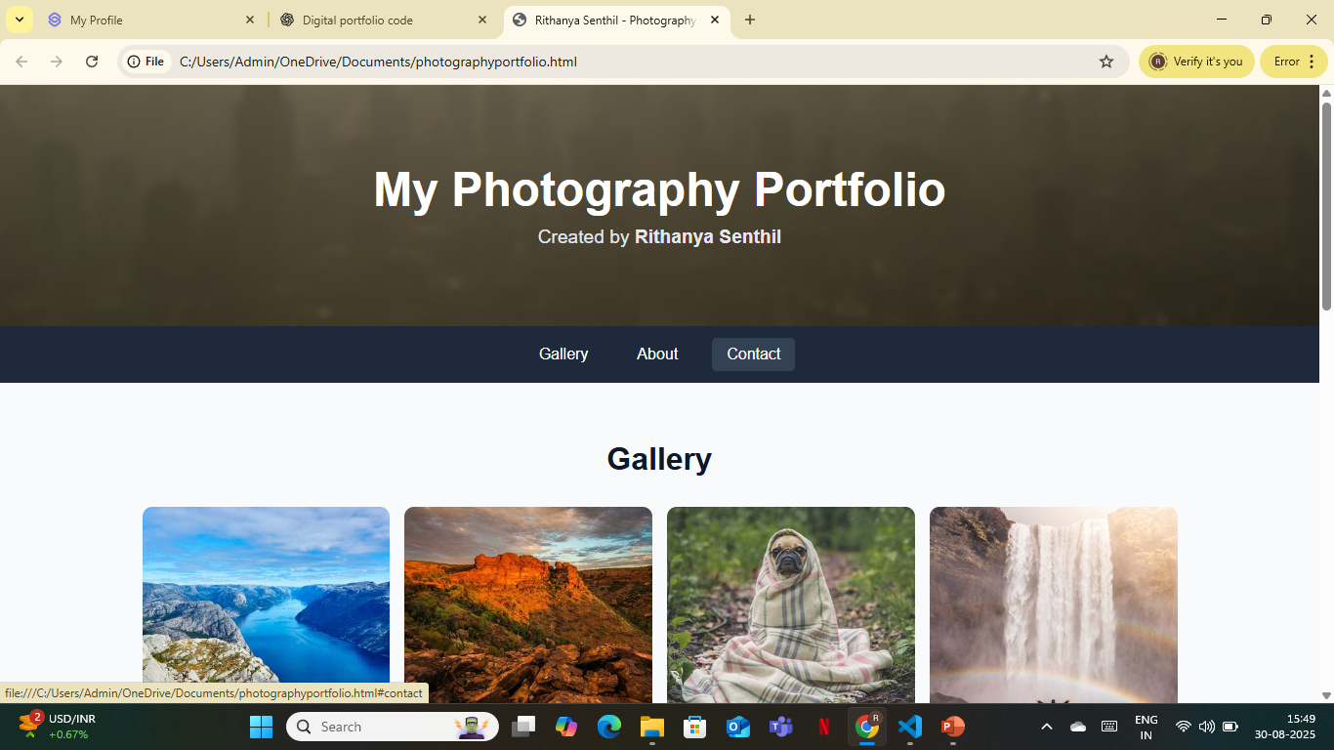
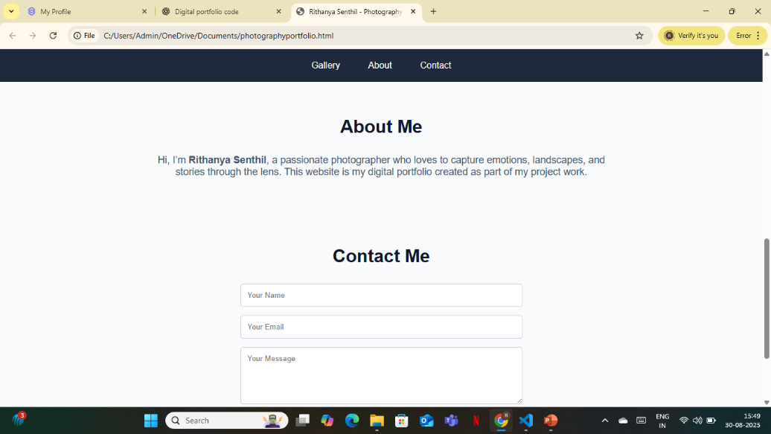

RESULTS AND SCREENSHOTS
3/21/2024 Annual Review
10

Slide 11
CONCLUSION
Successfully created a photography portfolio website
Learned the use of html ,css,javascript in real world projects
Website can be hosted onlone using github pages
Acts as a foundation for personal branding
11

